Slide 1
Hotel Booking Analysis Expolatory Data Analysis
Manoj Kumar

Slide 2
Topics for discussion
Introduction
Problem Statement
Treating Missing Values
EDA
Conclusion

Slide 3
Introduction:
This data set contains booking information for a city hotel and a resort hotel, and includes information such as when the booking was made, length of stay, the number of adults, children, and/or babies, and the number of available parking spaces, among other things

Slide 4
Problem Statement:
Have you ever wondered when the best time of year to book a hotel room is? Or the optimal length of stay in order to get the best daily rate? What if you wanted to predict whether or not a hotel was likely to receive a disproportionately high number of cancelation? or which hotel is more preferable to people in particular conditions?

Slide 5
Treating Missing Values
After loading the data set we look what is the data and variables in the data set and after we will use isnull function to see weather missing values present or not and we will treat the missing values with fullna function.
if it is a continuous variable and having missing values we will fill the missing values with mean or median according to the variable condition and if it is a categorical variable we will fill missing values with mode values

Slide 6
Merging numerical variables in to Groups
arrival_details=['arrival_date_year','arrival_date_week_number','arrival_date_day_of_month']
stays_details = ['stays_in_weekend_nights','stays_in_week_nights']
people_details = ['adults','children','babies']
cancelation_details =['previous_cancellations','previous_bookings_not_canceled']
agent_details = ['agent','company']
other_details=['days_in_waiting_list','required_car_parking_spaces','total_of_special_requests']

Slide 7
Exploratory Data Analysis
In Exploratory Data Analysis we have three step process
1. Univariative Analysis
2. Bivariative Analysis
3. Multivariate Analysis

Slide 8
Univariate Analysis
Univariative Analysis is a two step process
1.Univariate Analysis on numerical
variables
2.Univariate Analysis on categorical
variables

Slide 9
Univariate Analysis on numerical variables

Slide 10
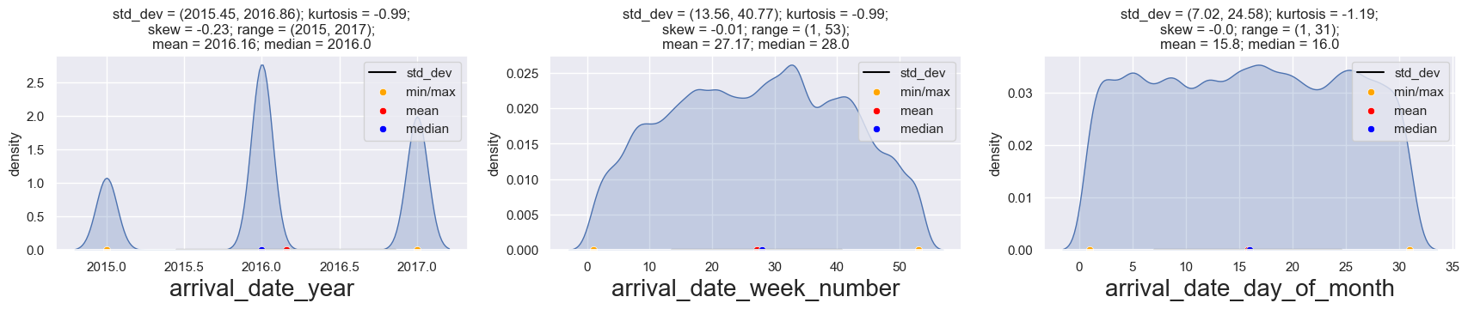
UVA_numeric(updated_data, arrival_details)

Slide 11
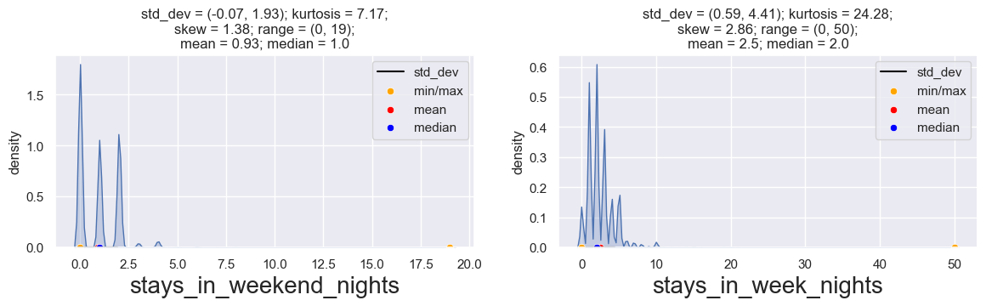
UVA_numeric(updated_data, stays_details)

Slide 12
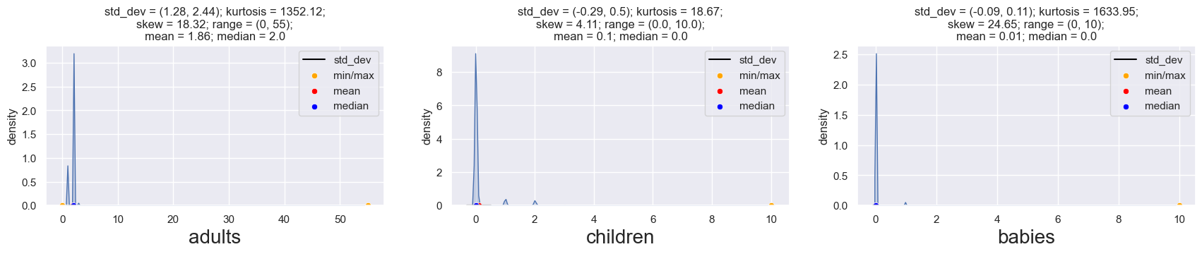
UVA_numeric(updated_data, people_details)

Slide 13
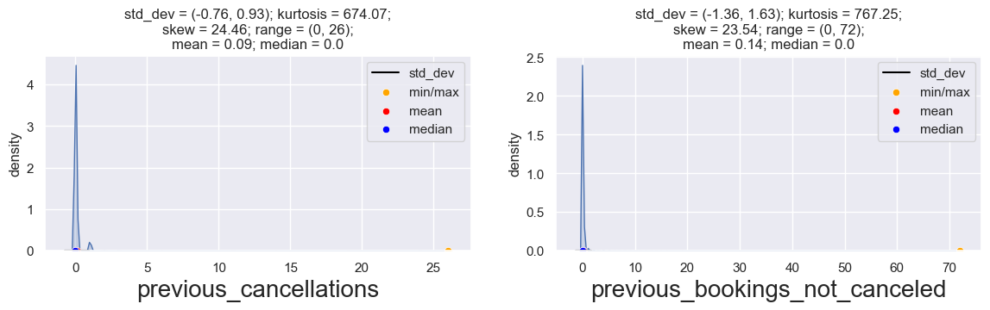
UVA_numeric(updated_data, cancelation_details)

Slide 14
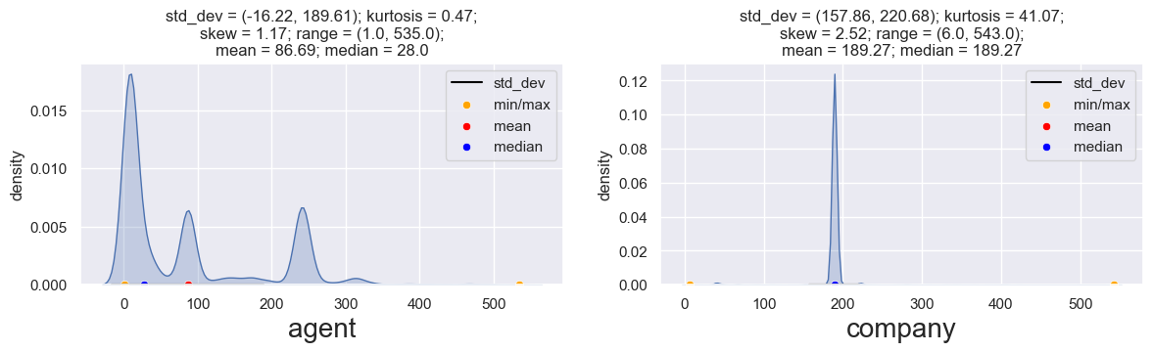
UVA_numeric(updated_data, agent_details)

Slide 15
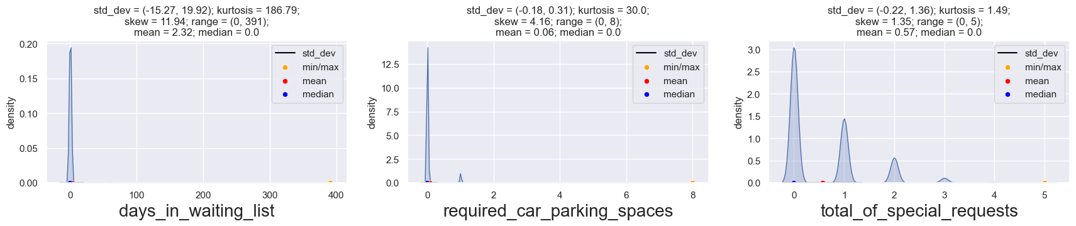
UVA_numeric(updated_data, other_details)

Slide 16
Univariate Analysis on categorical variables

Slide 17
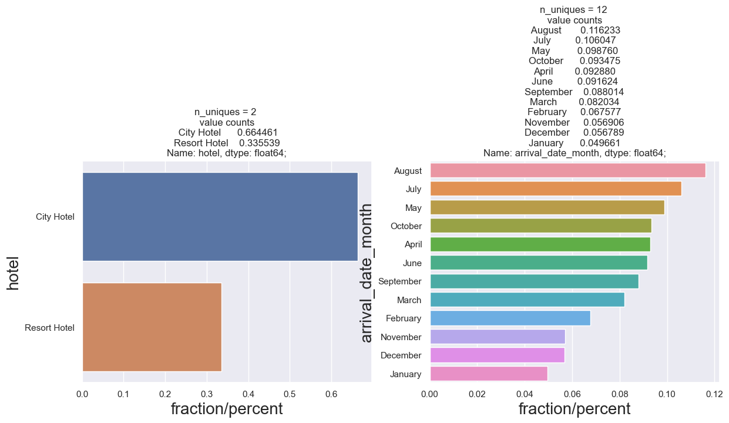
UVA_category(updated_data, ['hotel','arrival_date_month'])

Slide 18
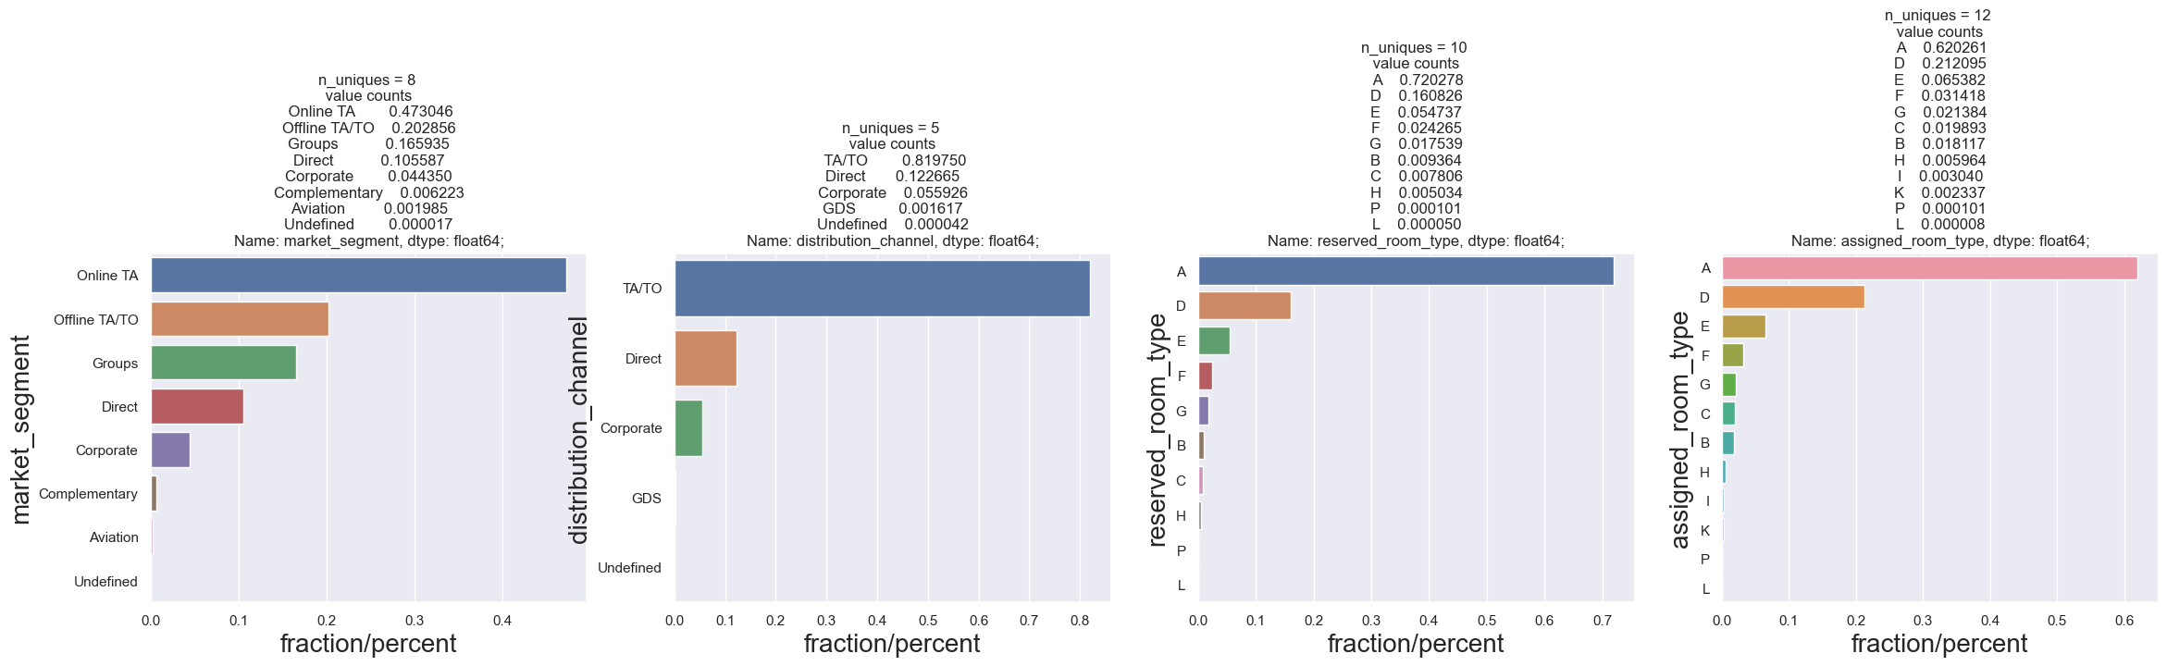
UVA_category(updated_data, ['market_segment','distribution_channel','reserved_room_type','assigned_room_type'])

Slide 19
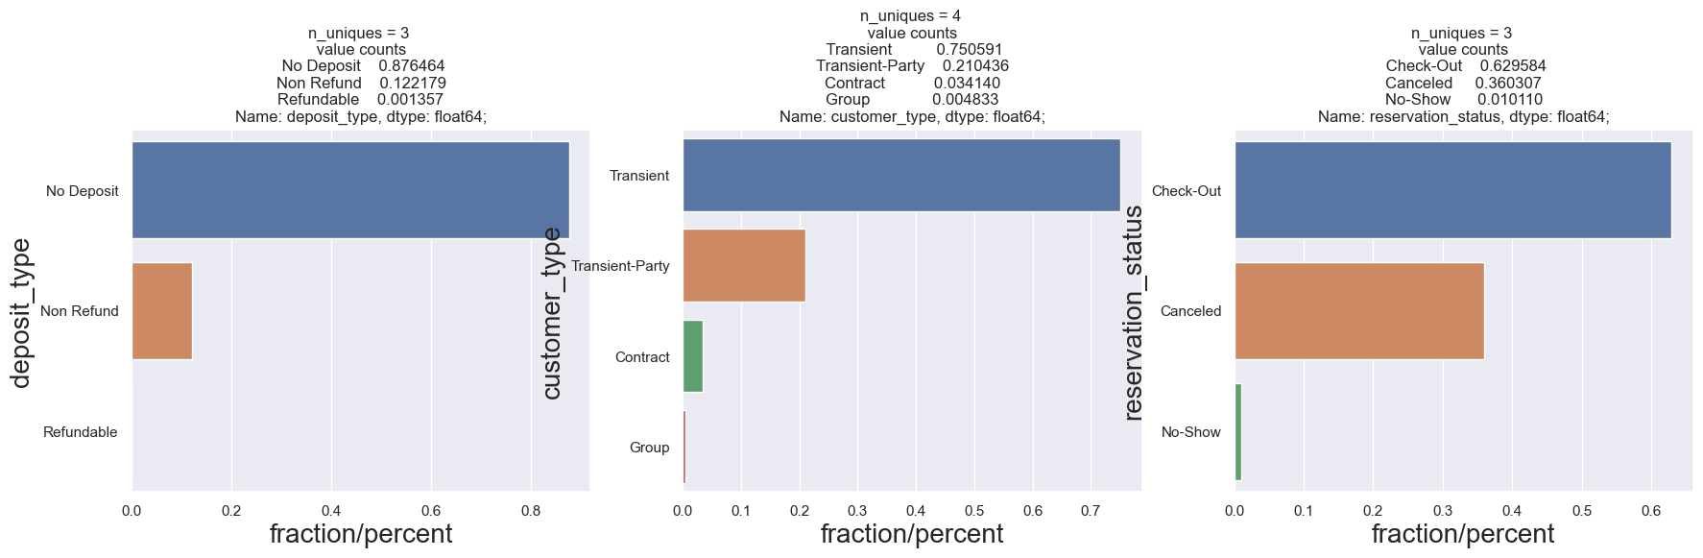
UVA_category(updated_data, ['deposit_type','customer_type','reservation_status'])

Slide 20
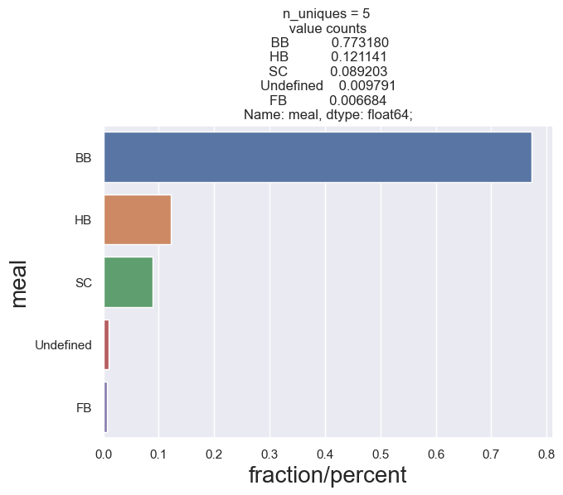
UVA_category(updated_data, ['meal'])

Slide 21
Bivariative Analysis

Slide 22
continuous-continuous variables
 |  | Pearson correlation
arrival_date_year | arrival_date_week_number | 0.540561
arrival_date_week_number | arrival_date_year | 0.540561
stays_in_week_nights | stays_in_weekend_nights | 0.498969
stays_in_weekend_nights | stays_in_week_nights | 0.498969
previous_bookings_not_canceled | is_repeated_guest | 0.418056
is_repeated_guest | previous_bookings_not_canceled | 0.418056
children | adr | 0.324853
adr | children | 0.324853
is_canceled | lead_time | 0.293123
lead_time | is_canceled | 0.293123

Slide 23
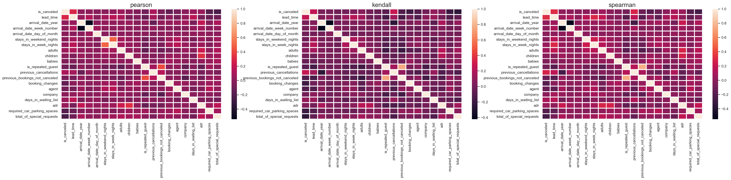
Heat Map

Slide 24
categorical-categorical variables
We will find out the relationship between hotel categorical variable to other categorical variables

Slide 25
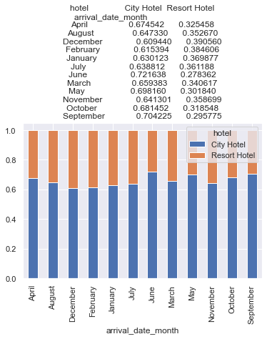
BVA_categorical(updated_data,'hotel','arrival_date_month')

Slide 26
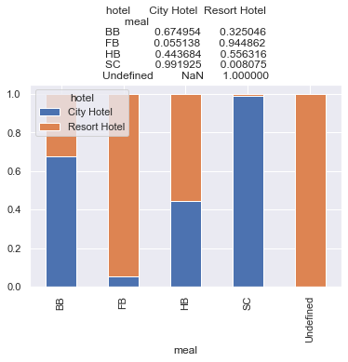
BVA_categorical(updated_data,'hotel','meal')

Slide 27
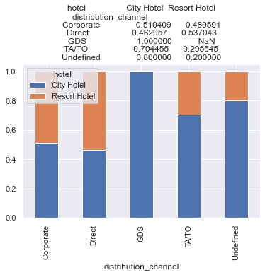
BVA_categorical(updated_data,'hotel','distribution_channel')

Slide 28
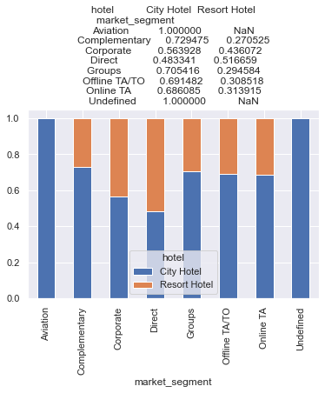
BVA_categorical(updated_data,'hotel','market_segment')

Slide 29
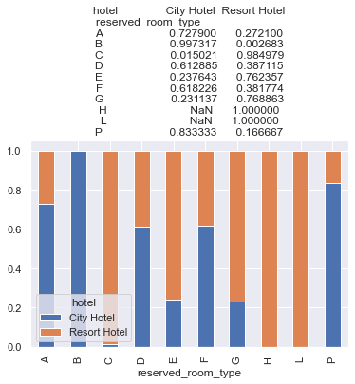
BVA_categorical(updated_data,'hotel','reserved_room_type')

Slide 30
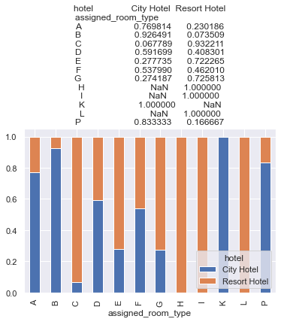
BVA_categorical(updated_data,'hotel','assigned_room_type')

Slide 31
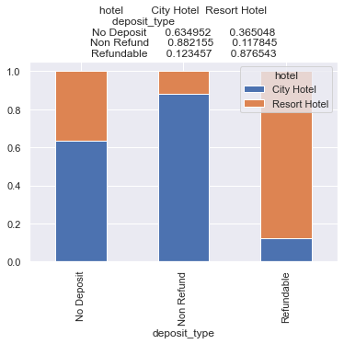
BVA_categorical(updated_data,'hotel','deposit_type')

Slide 32
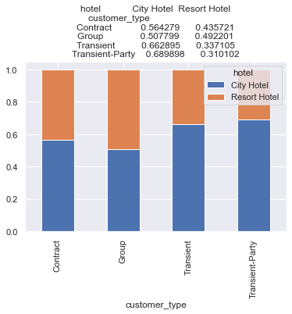
BVA_categorical(updated_data,'hotel','customer_type')

Slide 33
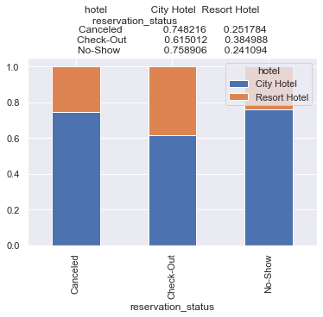
BVA_categorical(updated_data,'hotel','reservation_status')

Slide 34
MULTIVARIATE ANALYSIS

Slide 35
updated_data.pivot_table('agent',['hotel','arrival_date_month'],'deposit_type',aggfunc='mean')*100
 | deposit_type | 0 | 2 | 1
hotel | arrival_date_month
City Hotel | April | 2803.566926 | 5766.263128 | 2842.334546
 | August | 2602.316564 | 1608.531137 | 800.000000
 | December | 3346.605514 | 1875.685676 | NaN
 | February | 3499.220495 | 2725.686194 | NaN
 | January | 3535.941943 | 12987.837092 | NaN
 | July | 2301.447305 | 4327.041602 | 987.500000
 | June | 3602.516858 | 8396.783059 | NaN
 | March | 3366.384563 | 6160.851960 | 8669.338185
 | May | 3649.714102 | 5980.831597 | 900.000000
 | November | 3848.964643 | 6654.862502 | 6450.000000
 | October | 3259.703925 | 1904.383067 | 4650.000000
 | September | 2857.501818 | 1398.275146 | NaN
Resort Hotel | April | 20339.791236 | 22486.518819 | 19850.000000
 | August | 20180.382954 | 9572.745054 | 24000.000000
 | December | 18465.455835 | 8595.190254 | NaN
 | February | 17500.542396 | 12421.994390 | NaN
 | January | 17856.532726 | 24721.295402 | NaN
 | July | 20552.669994 | 8703.807141 | 24200.000000
 | June | 20531.787413 | 15925.798295 | 4000.000000
 | March | 18757.239092 | 22259.883721 | 8669.338185
 | May | 20310.489672 | 8870.440423 | 12146.023068
 | November | 18983.610884 | 10086.274510 | 8669.338185
 | October | 17698.104364 | 10906.756044 | 28269.230769
 | September | 18487.565641 | 10603.770075 | 36433.333333

Slide 36
updated_data.pivot_table('agent',['hotel','arrival_date_month'],'reservation_status',aggfunc='mean')*100
 | reservation_status | 1 | 0 | 2
hotel | arrival_date_month
City Hotel | April | 3660.693663 | 3125.901321 | 2851.048081
 | August | 1564.570394 | 3093.221816 | 4552.310304
 | December | 1854.255507 | 4017.031980 | 3818.993455
 | February | 2766.384979 | 3628.401349 | 5491.221359
 | January | 6598.590662 | 4073.616437 | 2644.929091
 | July | 2125.293524 | 2679.077188 | 3092.427443
 | June | 5809.503141 | 3730.463722 | 3218.167501
 | March | 3585.170732 | 3843.518607 | 4052.803306
 | May | 4087.019755 | 4117.420411 | 3090.495770
 | November | 4592.193257 | 4147.578976 | 4058.506584
 | October | 2378.264000 | 3395.749904 | 5329.883209
 | September | 1612.745386 | 3162.052117 | 4910.477923
Resort Hotel | April | 21737.142549 | 20029.520577 | 20629.143897
 | August | 21653.070921 | 19397.522705 | 19726.435415
 | December | 17519.946888 | 18209.755811 | 21707.712630
 | February | 17236.362329 | 17127.788273 | 17334.941539
 | January | 21726.562853 | 17317.935372 | 20765.615312
 | July | 22386.379647 | 19637.823621 | 18595.619741
 | June | 22638.979225 | 19281.256848 | 20575.000000
 | March | 22685.588129 | 17566.027738 | 18361.805777
 | May | 21617.771821 | 19269.956539 | 15926.582054
 | November | 20885.339798 | 18333.669239 | 18060.801456
 | October | 17643.995421 | 17088.830644 | 13698.305456
 | September | 17221.835345 | 17917.227528 | 20973.455869

Slide 37
updated_data.pivot_table('company',['hotel','arrival_date_month'],'deposit_type',aggfunc='mean')*100
deposit_type | 0 | 2 | 1
hotel | arrival_date_month
City Hotel | April | 18969.573852 | 19358.646965 | 15195.005149
 | August | 18627.053340 | 18642.579434 | 18926.673532
 | December | 18377.993398 | 18812.472935 | NaN
 | February | 18471.420042 | 18924.211156 | NaN
 | January | 18847.823963 | 16836.643869 | NaN
 | July | 18765.602735 | 18862.363423 | 18926.673532
 | June | 18812.517883 | 19171.280620 | NaN
 | March | 18783.348862 | 18926.673532 | 18500.000000
 | May | 18797.699240 | 18727.134203 | 18926.673532
 | November | 18575.890130 | 19018.306952 | 18926.673532
 | October | 18562.493001 | 18882.945912 | 18926.673532
 | September | 18586.979486 | 18908.852113 | NaN
Resort Hotel | April | 19338.552646 | 18712.745413 | 18926.673532
 | August | 18945.616138 | 18926.673532 | 18926.673532
 | December | 19224.310613 | 18926.673532 | NaN
 | February | 20162.946606 | 18926.673532 | NaN
 | January | 19006.148000 | 27257.848186 | NaN
 | July | 19013.810901 | 18926.673532 | 18926.673532
 | June | 19149.042567 | 18926.673532 | 18926.673532
 | March | 19746.858641 | 18926.673532 | 22300.000000
 | May | 19219.908788 | 17707.249663 | 22066.861851
 | November | 19833.244078 | 19106.542679 | 18926.673532
 | October | 19648.089551 | 18892.996910 | 18926.673532
 | September | 19068.363772 | 19869.528756 | 18926.673532

Slide 38
updated_data.pivot_table('company',['hotel','arrival_date_month'],'reservation_status',aggfunc='mean')*100
 | reservation_status | 1 | 0 | 2
hotel | arrival_date_month
City Hotel | April | 19113.686866 | 18986.796090 | 18632.175960
 | August | 18778.099065 | 18539.856718 | 17898.653711
 | December | 18803.019543 | 18196.921079 | 17931.561964
 | February | 18410.779948 | 18582.327645 | 18706.497913
 | January | 18136.705700 | 18796.406663 | 18015.839709
 | July | 18904.589518 | 18688.471680 | 18545.250944
 | June | 19060.930495 | 18745.615002 | 19494.485389
 | March | 18900.398457 | 18749.153471 | 18757.052242
 | May | 18882.204482 | 18704.934608 | 18941.392461
 | November | 18861.129396 | 18536.643064 | 17975.178451
 | October | 18845.046703 | 18466.723879 | 18831.901617
 | September | 18867.601201 | 18522.211667 | 17619.291599
Resort Hotel | April | 18932.121475 | 19415.891077 | 21494.291599
 | August | 18920.609893 | 18954.410606 | 19438.557292
 | December | 19245.348958 | 19205.258393 | 19144.871545
 | February | 20053.736670 | 20077.111850 | 20702.741028
 | January | 19004.930232 | 19151.969095 | 19455.444740
 | July | 19013.307108 | 19019.239521 | 18120.641459
 | June | 19003.498832 | 19210.909355 | 18926.673532
 | March | 19103.801746 | 19986.801943 | 17310.004846
 | May | 18836.562529 | 19322.025810 | 21288.392412
 | November | 19441.094928 | 19920.903103 | 17921.004119
 | October | 19113.528304 | 19762.952355 | 19660.612302
 | September | 19224.716373 | 19112.530952 | 19860.612302

Slide 39
Conclusion
That's it! We reached the end of our exercise.
In this exercise we see if there is any missing values present or not
we dealt with missing valuse by replacing with mean or median or mode values
we divided the numerical to categorical variables
we changed object type variables to category type
we grouped numerical variables into their respective groups according to their behaviour
Applied univariative analysis on both numerical and categorical variablesand we see the features in variables
Applied bivariative analysis numerical variables by generating heat map for pearson kendall spearman correlation and see the relationship between numerical variables
Applied bivariative analysis on categorical variables and see the relationship with our target variables to different other categorical variables
Applied multivariate analysis to see the relationship between three or more variables in cluding categorical and numerical variables

